Slide 1
Teach reading: change lives
Parent workshop: Phonics and early reading in Reception (Autumn Term) and Year 1
Notes:
For this presentation, you will need to download and print out the following resources and information for parents:
Phase 2 grapheme information sheet – Autumn 1
the parent handout ‘Your child’s reading journey – Reception Autumn term’
the Phase 2 and 3 grapheme mat
the Little Wandle Progression overview
‘Phase 2 tricky words: Reception Autumn term – Information for parents and carers’ – or parents can access this in the ‘For parents’ area of the Little Wandle website.
You will need a flipchart and access to the Little Wandle and Collins websites.
You may also wish to have a copy of the Little Wandle Glossary to hand (in Getting started/Teaching).

Slide 2
A love of reading is the biggest indicator of future academic success.
OECD (The Organisation for Economic Co-operation and Development)
Notes:
Slide purpose:
To share the link that research has established between loving reading and being successful academically
Suggested script:
Let's start our session with a quote from the Organisation for Economic Co-operation and Development ...
Read the quote.
This quote reminds us of the importance not just of teaching children to read, but also of teaching them to love reading.
Today, we're going to talk about phonics, but we always see phonics as the route into reading and a love of reading as the ultimate goal of phonics teaching.

Slide 3


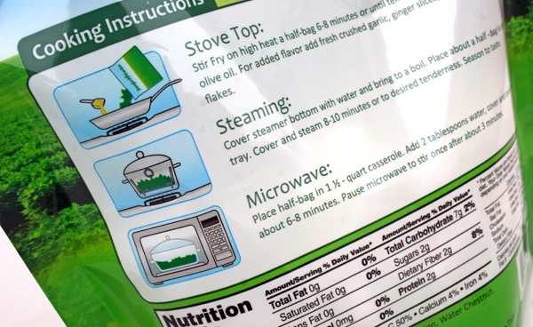
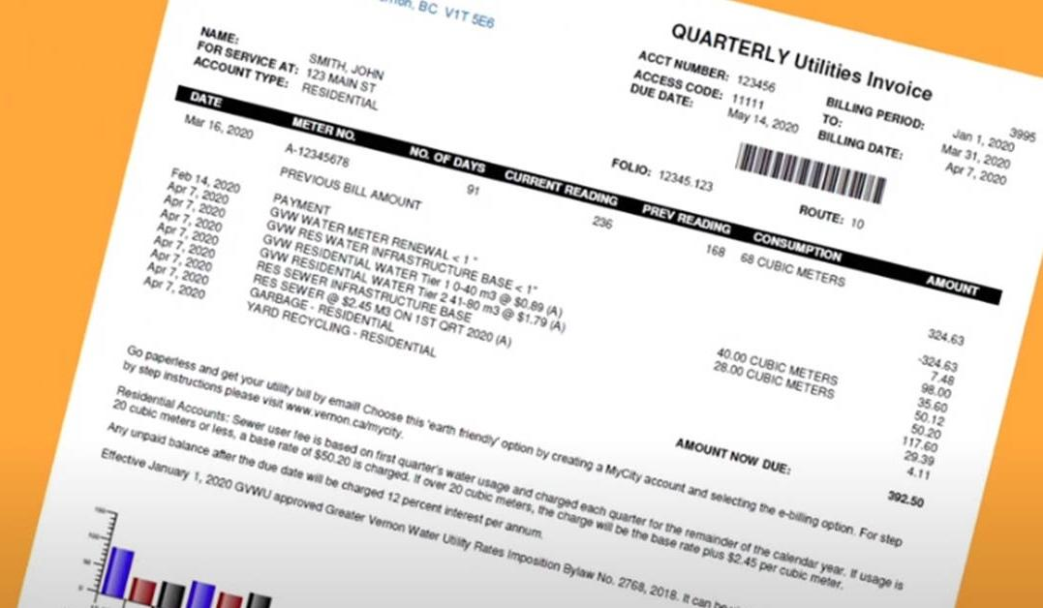
How many times have you already read today?
Notes:
Slide purpose:
To help parents see the value of reading by getting them to reflect on their own reading experiences
Suggested script:
Just think about how many times you have already read things today. More than ever, we are surrounded by text and reading is a vital skill.
We want all of our children to become confident readers who can navigate the world of reading around them.

Slide 4

Phonics

Slide 5

Little Wandle Letters and Sounds Revised
Our school has chosen
Little Wandle Letters and Sounds Revised as our Systematic Synthetic Phonics (SSP) programme to teach early reading and spelling.
Notes:
Slide purpose:
To inform parents that all schools must teach phonics in Reception, but explain your school's choice of SSP
Suggested script:
The National Curriculum specifies that all schools must teach children to read using phonics in Reception.
Read the slide.

Slide 6
Phonics is:
making connections between the sounds of our spoken words and the letters that are used to write them down.
Notes:
Slide purpose:
To provide a simple definition of phonics
Suggested script:
So what is phonics?
Read the slide.
It sounds complicated but it really isn’t!
Let's learn some important words that will help you understand phonics ...

Slide 7
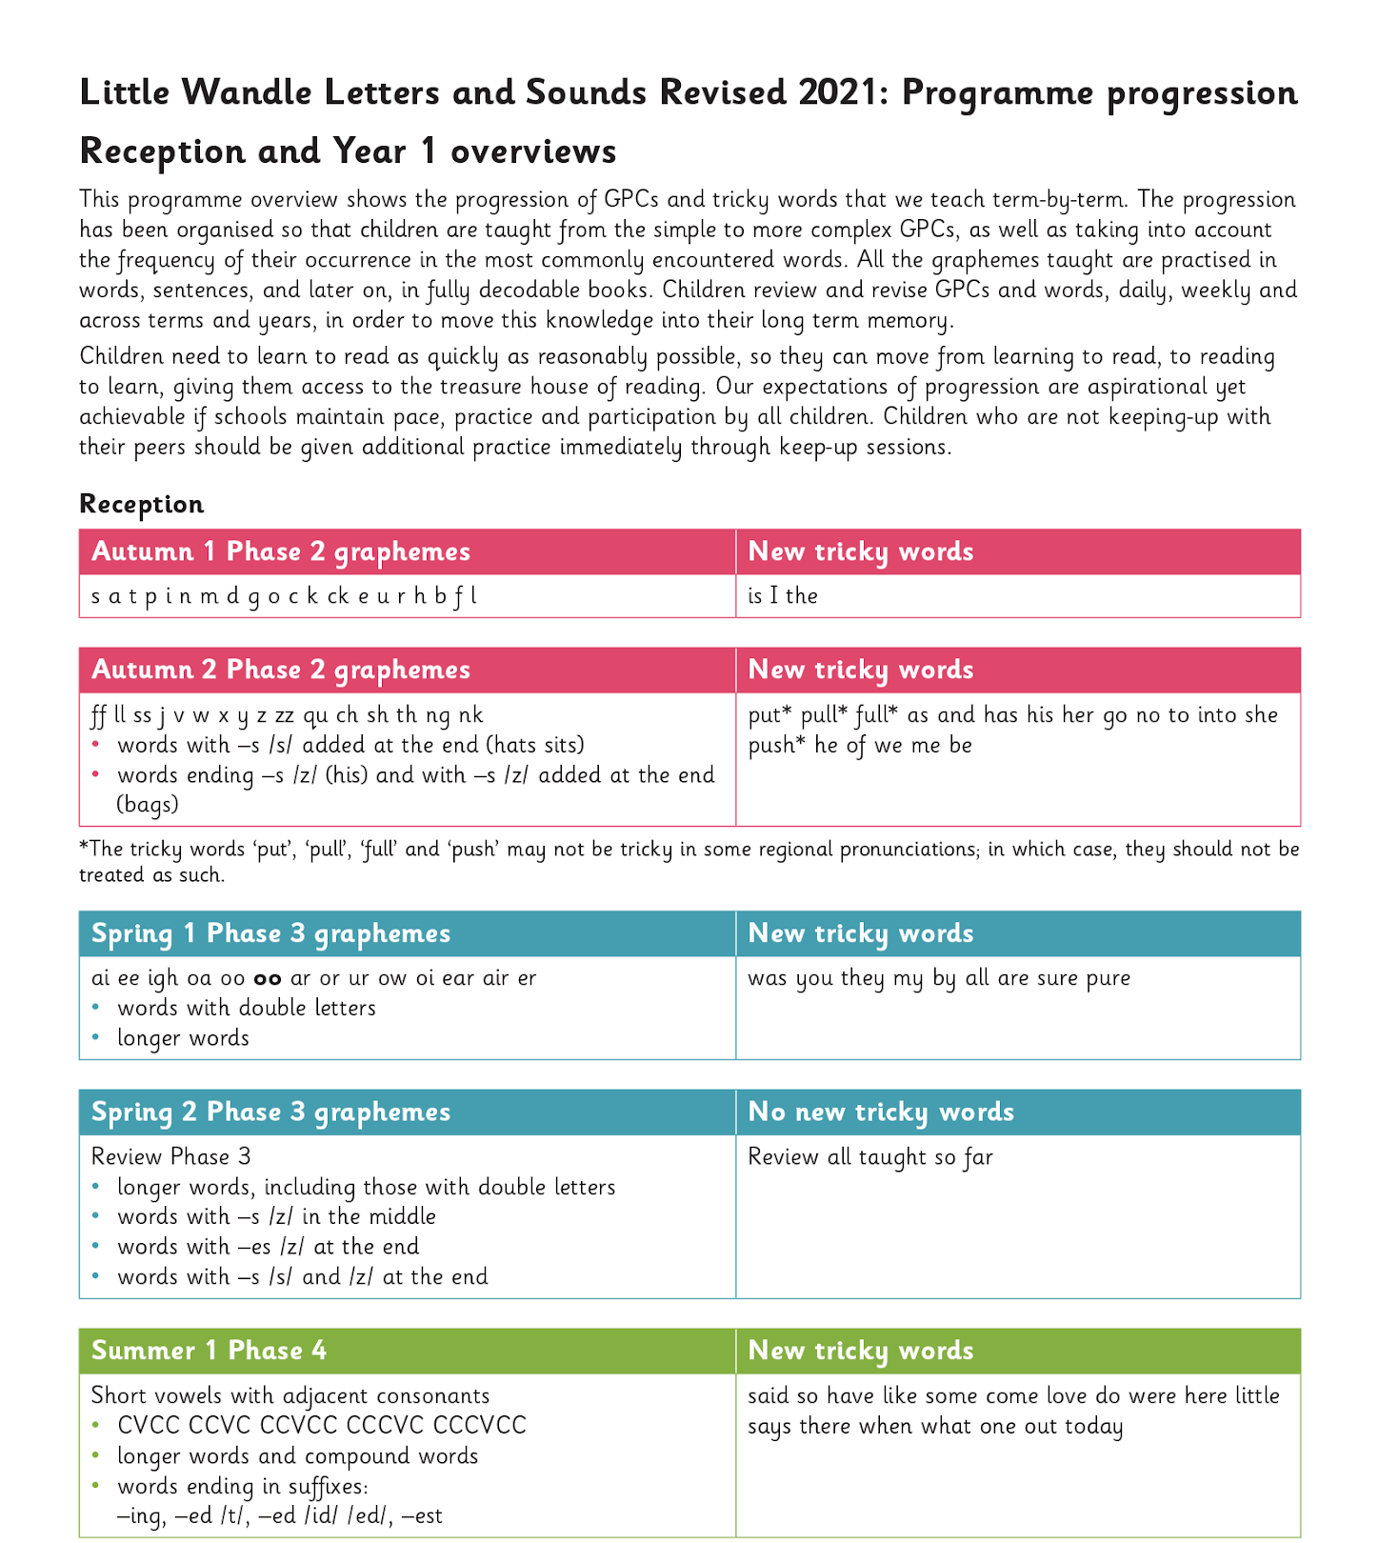
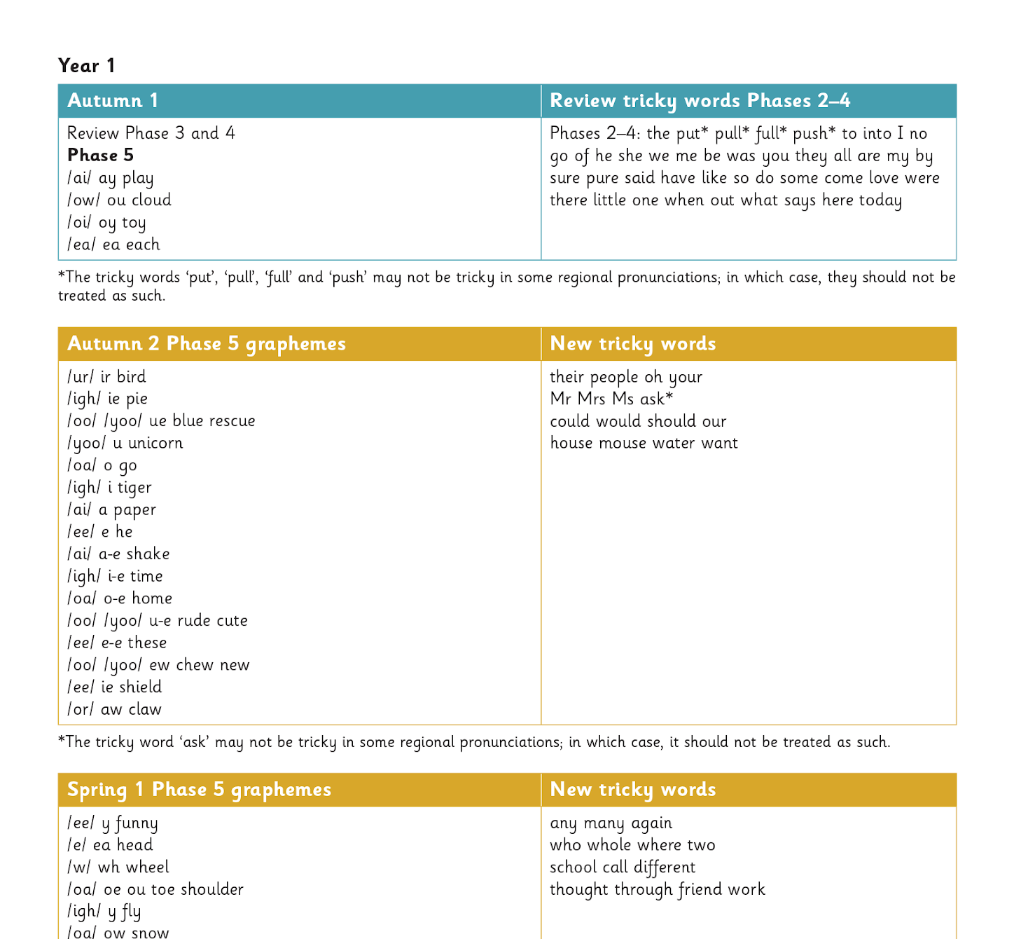
Our progression
Notes:
Slide purpose:
To provide an overview of the whole programme’s progression
Suggested script:
We will work our way through the whole Little Wandle Programme until your child can read fluently.

Slide 8
Terminology - there are some specific words we use in our phonic lessons…
Phoneme - a sound
Blend -saying the sounds in a word to read it
Grapheme - how we write the sound down
Segment- listening for sounds in a word to write it
Digraph - two letters making one sound
Trigraph -three letters making one sound
Notes:
Slide purpose:
To give simple definitions of key terminology
Suggested script:
Review what each word means – use the Glossary to help.
Children will have already learned most of these terms. In Year 1, split digraphs are introduced.

Slide 9
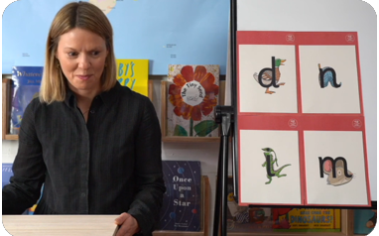
Let’s start with Reception…
This term we are teaching Phase 2
These are the first group of letters and sounds your child will learn.
We start teaching from week 2 of Reception.
The lessons are fun, interactive, engaging and have been designed to gradually build over time.
Notes:
Slide purpose:
To introduce Phase 2
Notes
Read the slide.

Slide 10


We teach Phase 2 in this order
Notes:
Slide purpose:
To provide an overview of the Phase 2 sounds
Suggested script:
We usually teach four new sounds a week and have a review lesson on a Friday.
You will get a list of the sounds that we are learning to have at home. This will help you with letter formation (handwriting) and pronunciation.
Give the Phase 2 grapheme information sheet for Autumn 1 to parents.

Slide 11
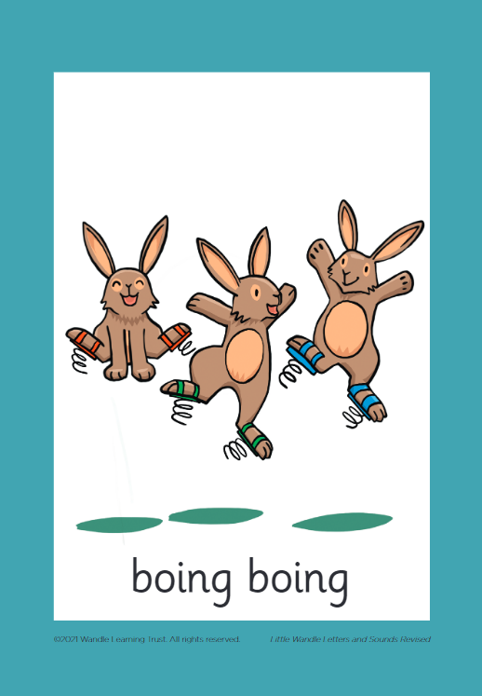



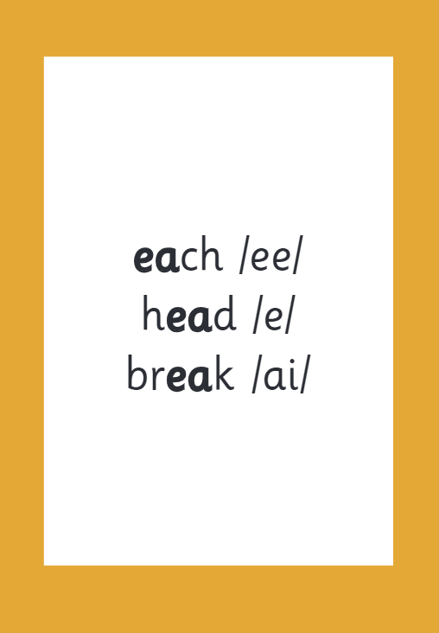

How we make learning stick
Notes:
Slide purpose:
To provide an overview of the programme’s efficacy
Suggested script:
There are specific resources for the Little Wandle Programme which the children will be very familiar with.
Each sound that we teach to begin with has either a mnemonic (like the astronaut that you can see here) or a phrase like boing-boing for ‘oi’. This helps the children recognise and remember the graphemes.
Every time we teach a new sound, we also read words during the phonics lesson that contain that new sound so that the children practise what they have learned.
We then go on to reading a sentence containing some of those words.
We have displays in the classroom and on the tables to support the children throughout the day.

Slide 12
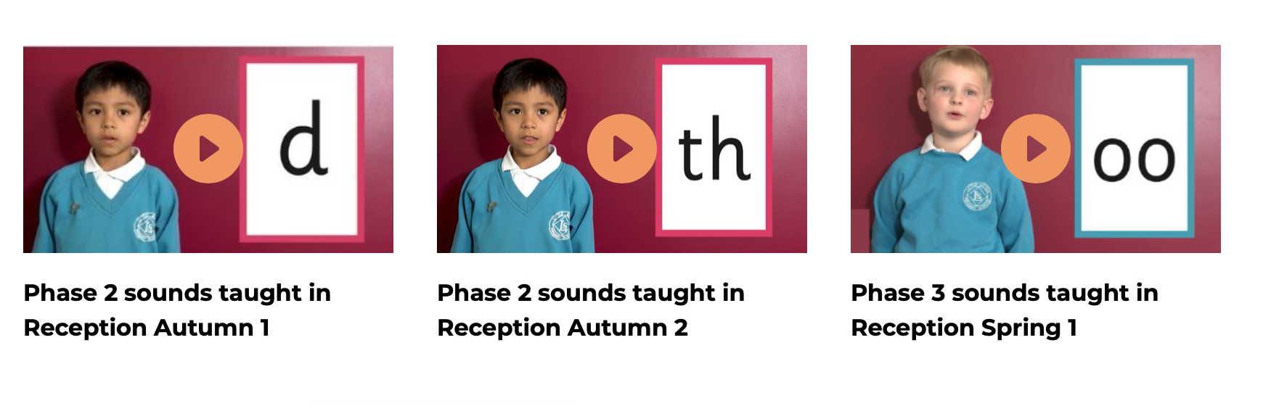
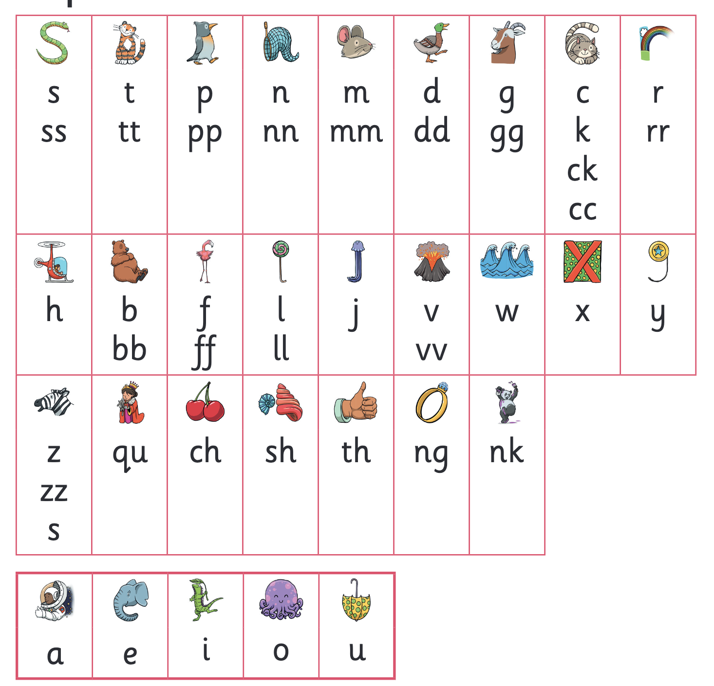
Let’s say the Phase 2 sounds
youtube.com/watch?v=-ZtjFIvA_fs&feature=youtu.be
https://www.youtube.com/watch?v=qDu3JAjf-U0
Notes:
Slide purpose:
To practise the Phase 2 sounds
Notes
Give out the parent handout and the Phase 2 and 3 grapheme mat.
Play the videos/teach the parents to say the Phase 2 sounds: https://www.littlewandlelettersandsounds.org.uk/resources/for-parents/
Show parents where to access these videos in the ‘For parents’ area of the Little Wandle website.

Slide 13
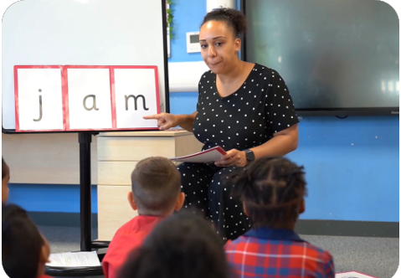
We teach blending so your child learns to read
Teacher-led blending is taught throughout Phase 2.
Our aim to is to teach every child to blend by Christmas.
We will inform you if your child needs additional practice.
Notes:
Slide purpose:
To introduce blending
Suggested script:
Teacher-led blending is teaching children how to blend, directed and demonstrated by the teacher.
It is repeated daily in the Autumn term.

Slide 14

Blending to read words
https://www.littlewandlelettersandsounds.org.uk/resources/for-parents/#tabnametabHowWeTeach
Notes:
Slide purpose:
To provide an overview of blending
Suggested script:
Some children learn to blend really quickly, and others take a little longer.
If your child is finding it difficult, ask your child’s teacher for ways to help at home – playing blending games at home is so helpful!
Show parents the ‘How we teach blending’ video from ‘For parents’ area of the website: https://www.littlewandlelettersandsounds.org.uk/resources/for-parents/

Slide 15
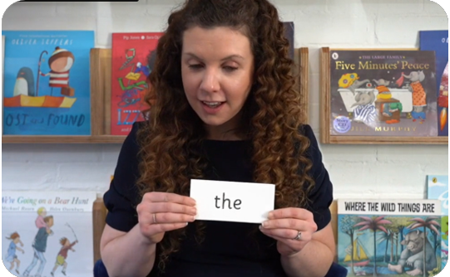
Tricky words
These words have unusual spellings e.g. he, the, was.
They are taught in a systematic way.
Children are now learning to read the Phase 2 tricky words: is, I, the, put, pull, full, as, and, has, his, her, go, no, to, into, she, push, he, of, we, me, be.
Notes:
Slide purpose:
To introduce tricky words
Notes:
Read the slide.
You may wish to give parents a copy of the document ‘Phase 2 tricky words: Reception Autumn term – Information for parents and carers'.

Slide 16
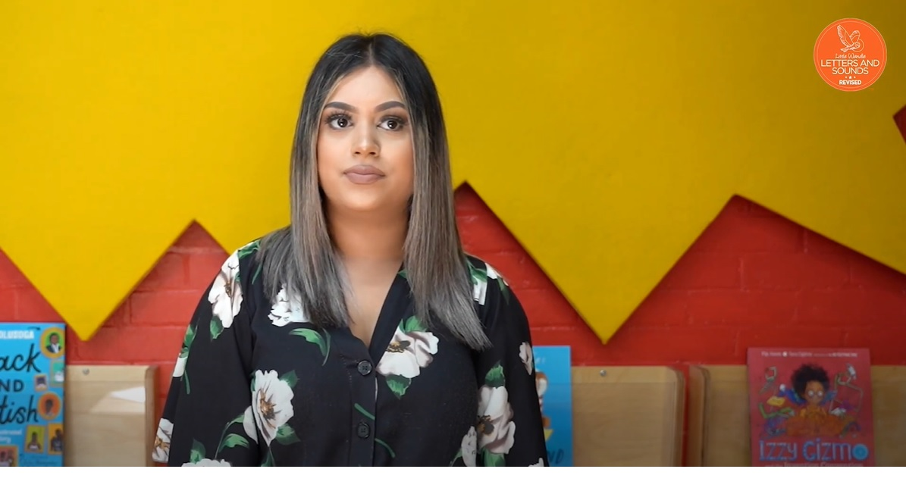
Reading tricky words
https://www.littlewandlelettersandsounds.org.uk/resources/for-parents/#tabnametabHowWeTeach
Notes:
Slide purpose:
To provide an overview of tricky words
Notes
Watch the ‘How we teach tricky words’ video on the website: https://www.littlewandlelettersandsounds.org.uk/resources/for-parents/

Slide 17
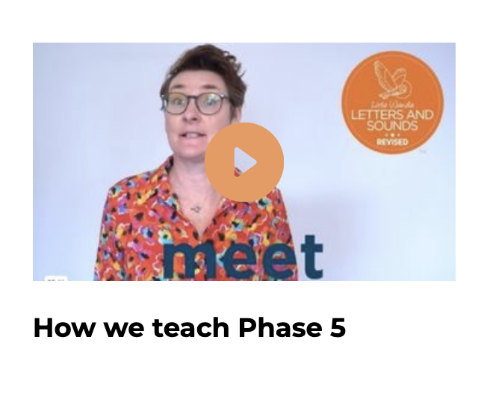
Now Year One
This term we are teaching Phase 5
In Phase 5 children learn:
new graphemes for the sounds they already know
that the same grapheme can have alternative pronunciations.
The ‘Grow the code’ lessons support children with reading and spelling these alternative spellings.
https://www.littlewandle.org.uk/resources/for-parents/#tabnametabHowWeTeach
Notes:
Slide purpose:
To provide an overview of Phase 5 'Grow the code’
Suggested script:
The children learn the last set of graphemes, including ones with alternative pronunciations.
Play the video which explains how we teach Phase 5. (The first 20 seconds are a repeat of the ‘How to say the sounds’ video but then goes on to explain what the alternative graphemes are for the sound /ai/.)
They will also learn to ‘Grow the code’ where children will explore different ways of spelling the same phoneme and reading the same grapheme. This means that they are able to read increasingly challenging words and books.
Children learn strategies so that they can distinguish between the same grapheme, different phoneme and the same phoneme but different grapheme. ‘Growing the code’ will support children as they get older with accurate spelling.

Slide 18
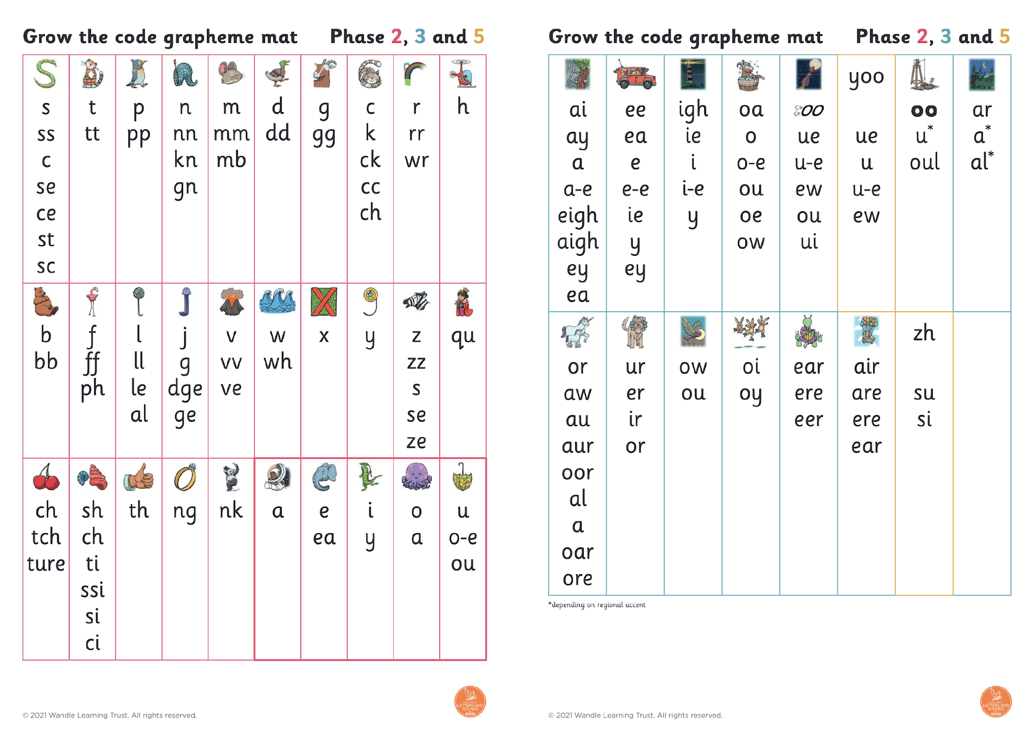
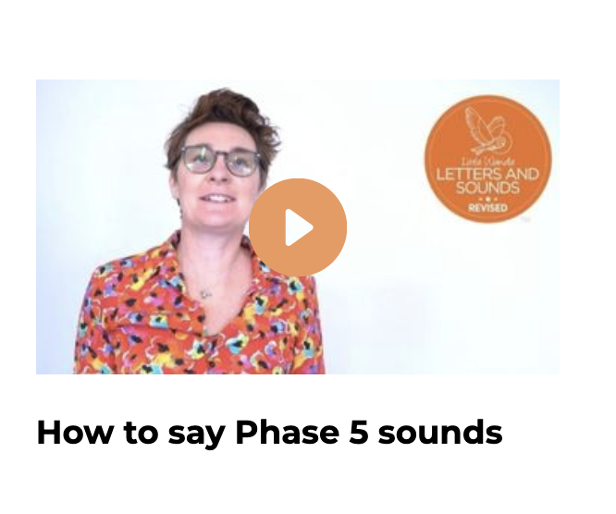
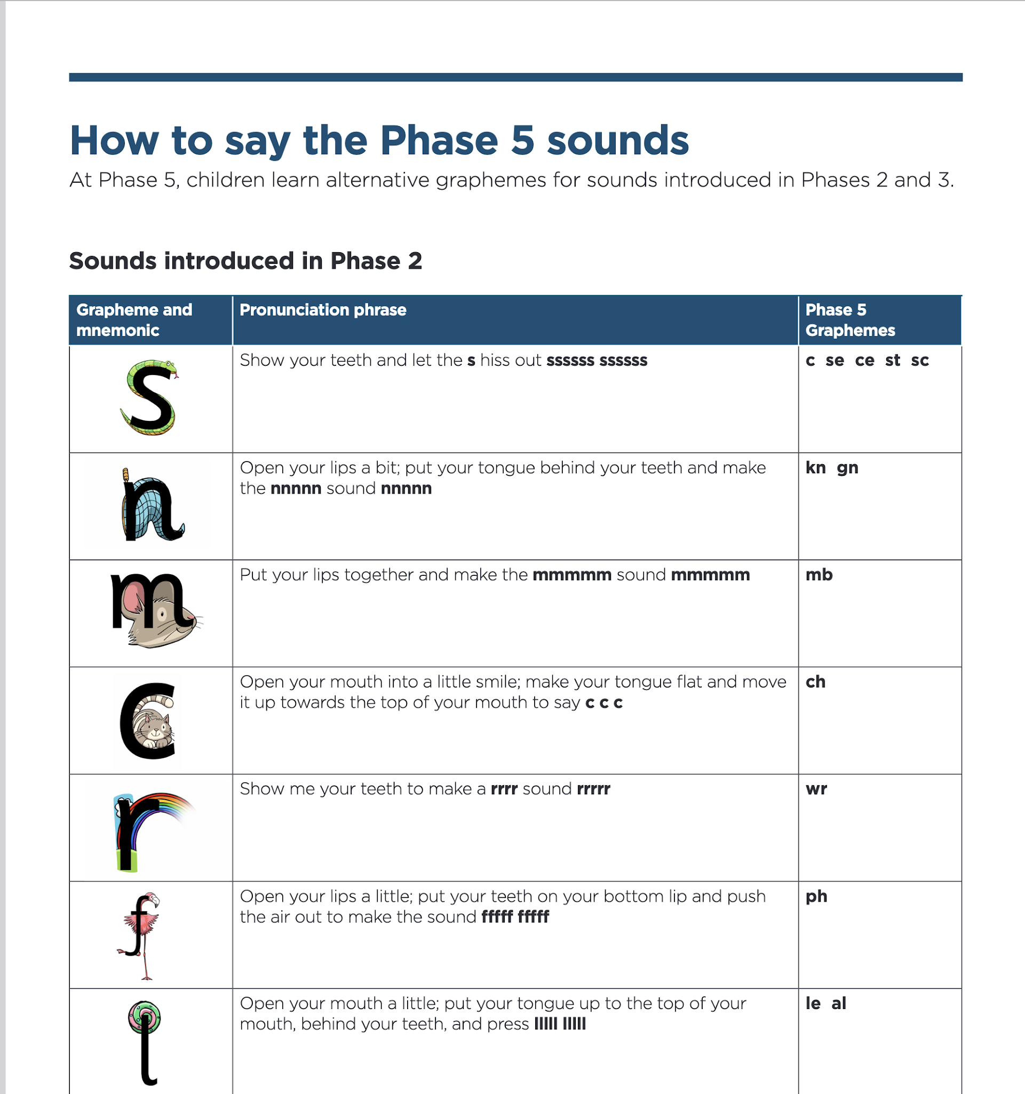
Now Year One…
Let’s say the Phase 5 sounds
https://www.littlewandle.org.uk/resources/for-parents/#tabnametabSupportForPhonics
Notes:
Slide purpose:
To introduce the Phase 5 GPCs and how to say them
Suggested script:
Let's have a look at the Phase 5 sounds.
Hand out the Phase 5 handout and the ‘Grow the code’ mat.
Play the video and pause it so the parents can say the sounds if you wish.
Or display the ‘Grow the code’ chart and teach the parents the sounds.
Have a look at your handout and watch this video/look at the ‘Grow the code’ chart on the screen.
Now, let's have a practice!

Slide 19
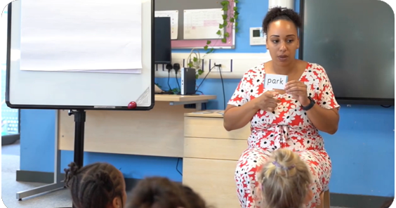
Reading words
Children will be able to:
blend independently
blend in their heads with increasing fluency and confidence.
They will also begin to distinguish between different phonemes/graphemes.
Notes:
Slide purpose:
To introduce the strategies that children need to become fluent readers
Suggested script:
Most children will now be confident using the strategy ‘blend in your head’ to build their fluency.
Blending in your head means children say the sounds quietly in their heads and then read the whole word out loud.
If your child is struggling with a word, encourage them to blend in their head.
Children are also taught to spot digraphs in words before reading the word as a whole. This also helps their developing fluency.
Show parents how to spot digraphs in words. Show a word such as ‘head’. Point to ‘ea’ and say: This is a digraph. Model reading the word: h-ea-d head. Show another word e.g. ‘bread’. Ask parents to spot the digraph and read the word: b-r-ea-d bread.
Eventually, reading becomes automatic and children will be able to read words that they know fluently.
Fluency is the ultimate goal of phonics teaching and fluent reading is explicitly taught.

Slide 20
Reading and spelling

Slide 21
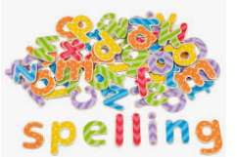
Spelling
Your child will be taught how to spell simple words, using the graphemes they have been taught.
In Reception we use magnetic letters instead of writing at this stage.
Year 1 spell words as part of their phonic lesson and will have spellings to practice at home each week.
Notes:
Slide purpose:
To introduce spelling
Notes:
Read the slide.
Hand out the Phase 2 grapheme information sheet for Autumn 1, which includes the formation phrases.

Slide 22

How do we teach spelling?
Say the word.
Segment the sounds.
Count the sounds.
Write them down.
Notes:
Slide purpose:
To provide an overview of spelling
Notes:
Model the process above on a flipchart for the parents to see.
Show the process with a Phase 2 word, e.g. pin, dig, hug.

Slide 23


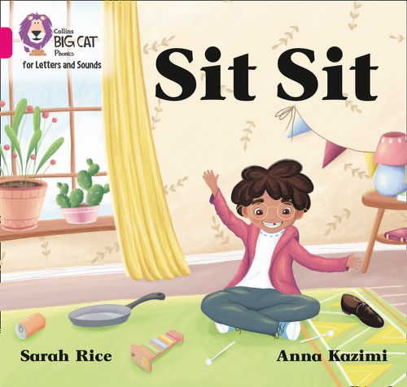
How do we practise reading in books?
Reading practice sessions are:
timetabled every day
taught by a trained teacher/teaching assistant
taught in small groups
children in Reception will bring a book home by week 4 of the first half-term.
Year One are already bringing their book home.
Notes:
Slide purpose:
To introduce decodable books
Suggested script:
The children read the same book three times in a week.
The first time we work on decoding (sounding out) the words, the second time we work on prosody which is reading with expression – making the book sound more interesting with our story-teller voice or our David Attenborough voice – and the third time we look at comprehension.
We read the books three times at school because we want to develop the fluency.
The more children see words, the more they begin to read them automatically without having to sound them out.

Slide 24




How do we find the right book for your child?
Notes:
Slide purpose:
To introduce book matching
Suggested script:
We assess your child every six weeks to check progress.
Any child who needs extra support has Daily Keep-up sessions planned for them.

Slide 25
Reading at home

Slide 26





Books going home
Notes:
Slide purpose:
To introduce the process and format for reading at home
Suggested script:
As well as the ‘learning to read’ book that your child will bring home they will also bring home a book for sharing with you.
This shared book is SO important. This is how we are going to give them the WILL to read.
Please read with your child as often as you can – at least once a day if possible.

Slide 27
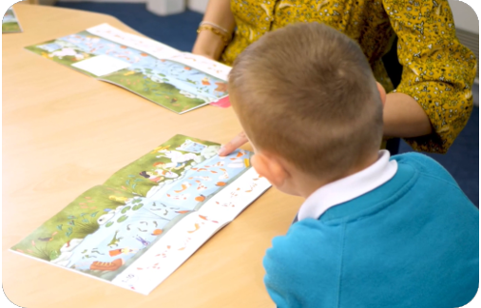
Reading a wordless books
Wordless books are invaluable as they teach reading behaviours and early reading skills to children who are not blending – yet!
Talk about the pictures.
Point to the images in the circles and find them on the page.
Encourage your child to make links from the book to their experiences.
Notes:
Slide purpose:
To give guidance on reading wordless books at home
Notes:
Read the slide.

Slide 28
Listening to your child read their phonics book
Your child should be able to read their book without your help.
They might sound out words and blend them before they read them fluently.
If they can’t read a word, read it to them.
Talk about the book and celebrate their success.
Notes:
Slide purpose:
To give guidance on reading the decodable book at home
Notes
Read the slide.

Slide 29

Read to your child
The shared book is for YOU to read:
Make the story sound as exciting as you can by changing your voice.
Talk with your child as much as you can:
  Introduce new and exciting language.
  Encourage your child to use new vocabulary.
  Make up sentences together.
  Find different words to use.
  Describe things you see.
Notes:
Slide purpose:
To give guidance on reading the shared book at home
Notes:
Read the slide.

Slide 30
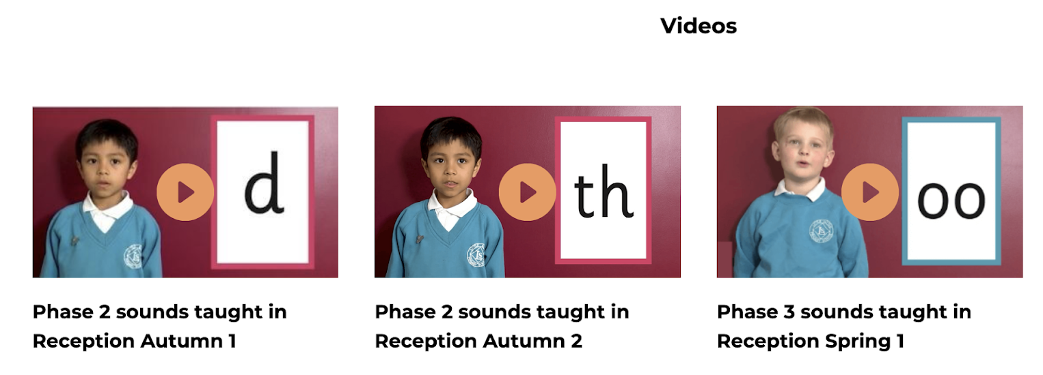
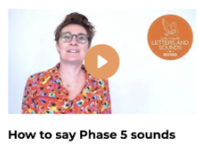
Supporting your child with phonics
The Little Wandle Website has lots of really useful information.
https://www.littlewandlelettersandsounds.org.uk/resources/for-parents/#tabnametabHowWeTeach
And don’t forget you can always ask one of the school staff. We would be more than happy to answer any of your questions.
Notes:
Slide purpose:
To give guidance on supporting phonics learning at home
Suggested script:
It is really important that you pronounce the sounds correctly at home if you are supporting your child.
Use the videos we saw earlier for support.

Slide 31
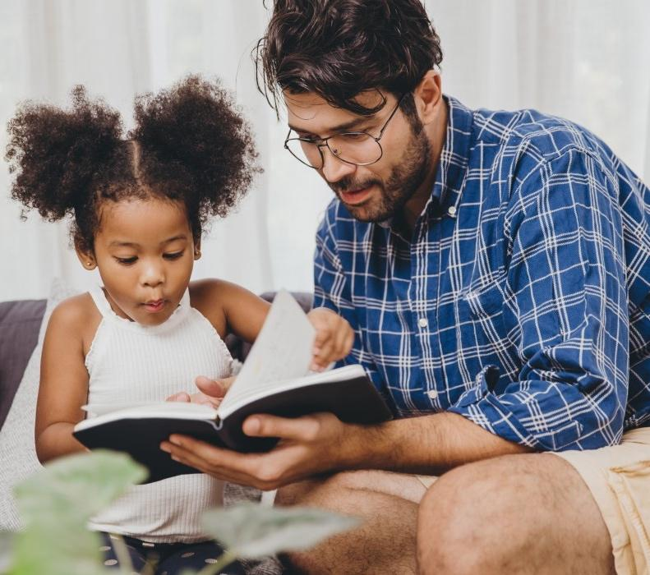
The most important thing you can do is read with your child
Reading a book and chatting had a positive impact a year later on children’s ability to…
understand words and sentences
use a wide range of vocabulary
develop listening comprehension skills.
The amount of books children were exposed to by age 6 was a positive predictor of their reading ability two years later.
Parental involvement in the development of children’s reading skills: A five-year longitudinal study (2002) Senechal, M. and Lefvre, J
Notes:
Slide purpose:
To summarise key takeaways
Suggested script:
Celebrate your child’s success at school.
Make time for reading at home!

Slide 32
One of the greatest gifts adults can give is to read to children
Carl Sagan
Notes:
Slide purpose:
Key takeaways/final message
Notes:
Read the quote.

